Slide 1

Helpful tips for writing pofanfiction (using linear regression)
Sean Flanagan

Slide 2
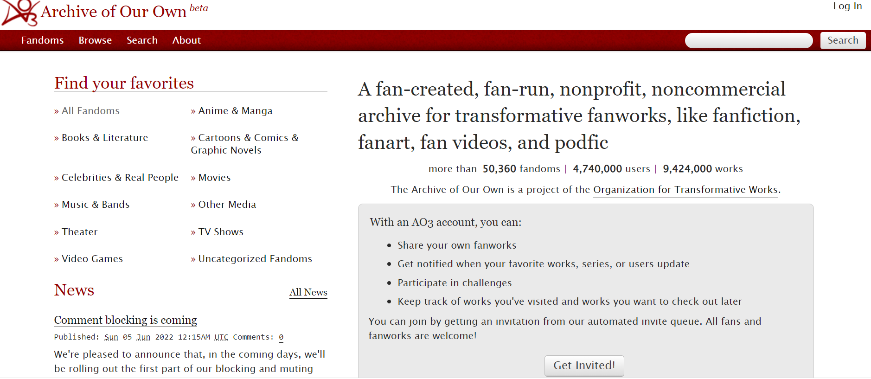
AO3 and my goal
AO3 has millions of users posting millions of stories
Very little content moderation but…
Very robust technical guides and tips
Maybe a tip guide for best practices for new authors

Slide 3
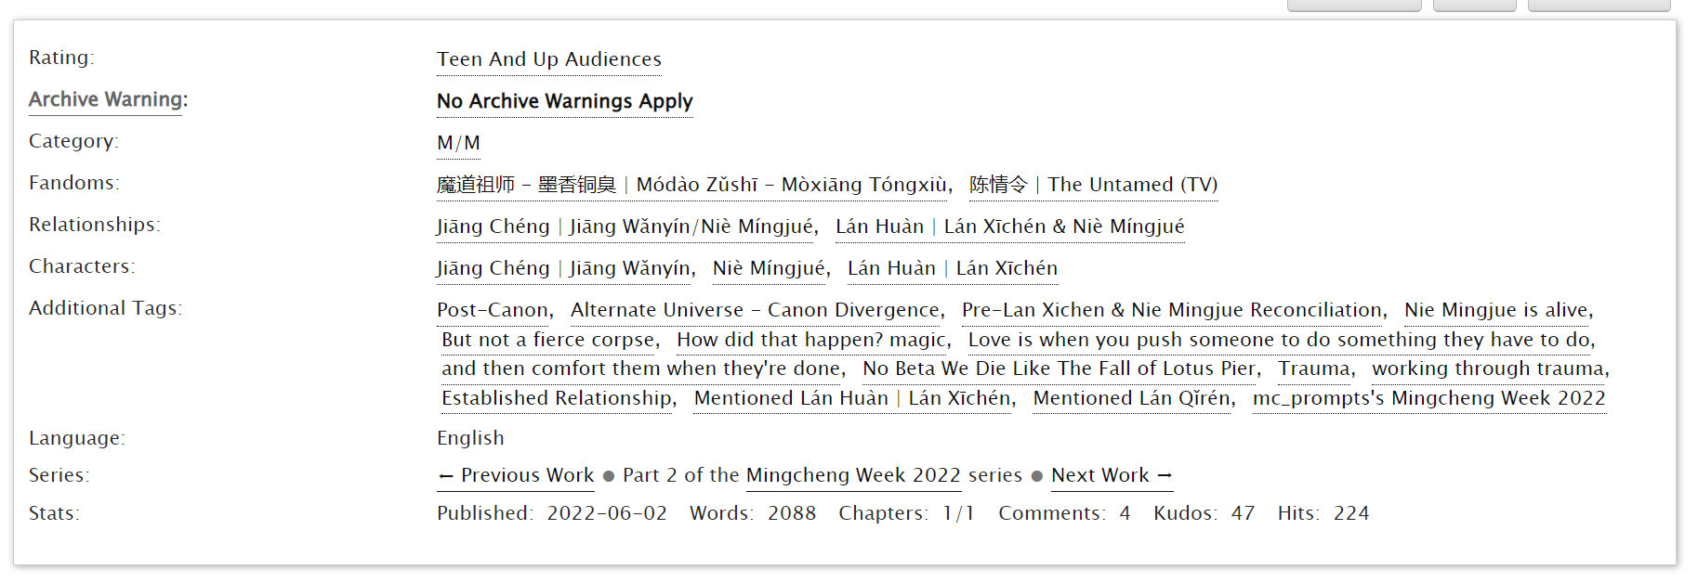
Webscraping metadata

Slide 4
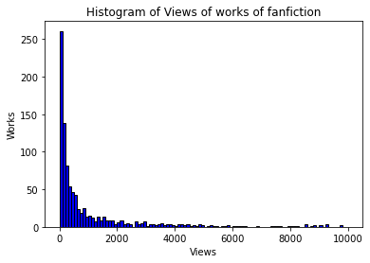
Target Feature: Hits

Slide 5
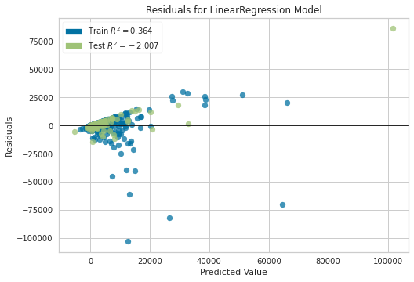
Baseline Model
7 features:
Word count
# of chapters
# of warnings
# of relationship tags
# of character tags
# of freeform tags
# of fandoms
RMSE: 6999
6999.165357120866 48988315.69632087

Slide 6
CV and Feature Engineering
Baseline mean R^2 - 0.145
Eliminate tag features – 0.158
Eliminate word count - 0.091
Multiply word count/chapter count - 0.047
Square word count - 0.046
Add sentiment scores from vader - 0.16

Slide 7
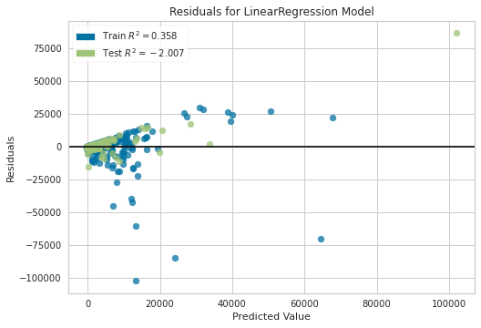
Final Model
3 features
Word Count
# of chapters
Compound sentiment scores
RMSE: 6782

Slide 8
Interpretations and Followup
Misunderstood how posts get views / how people find content
Community of niches
In the future, maybe restrict domain
Poisson Regression
More NLP

Slide 9
Thank you

